Slide 10
MIERC • WED 28 NOV, 2018 9:AM – 2:PM
San Diego Central Library, Downtown
Sostenibilidad del Agua Fronteriza
Transborder Water Sustainability
Smart City
Keynote Speaker
JUEV • THUR 29 NOV, 2018 9:AM – 5:PM
Real Inn, Tijuana, B.C.
Keynote Speaker, Green Agora, Project Faire, Directory
Infraestructura Verde, Finanzas y Entregables
Green Infrastructure, Finances & Deliverables
Sostenibilidad del Agua
Water Sustainability
Smart City/Smart Mobility

Slide 12
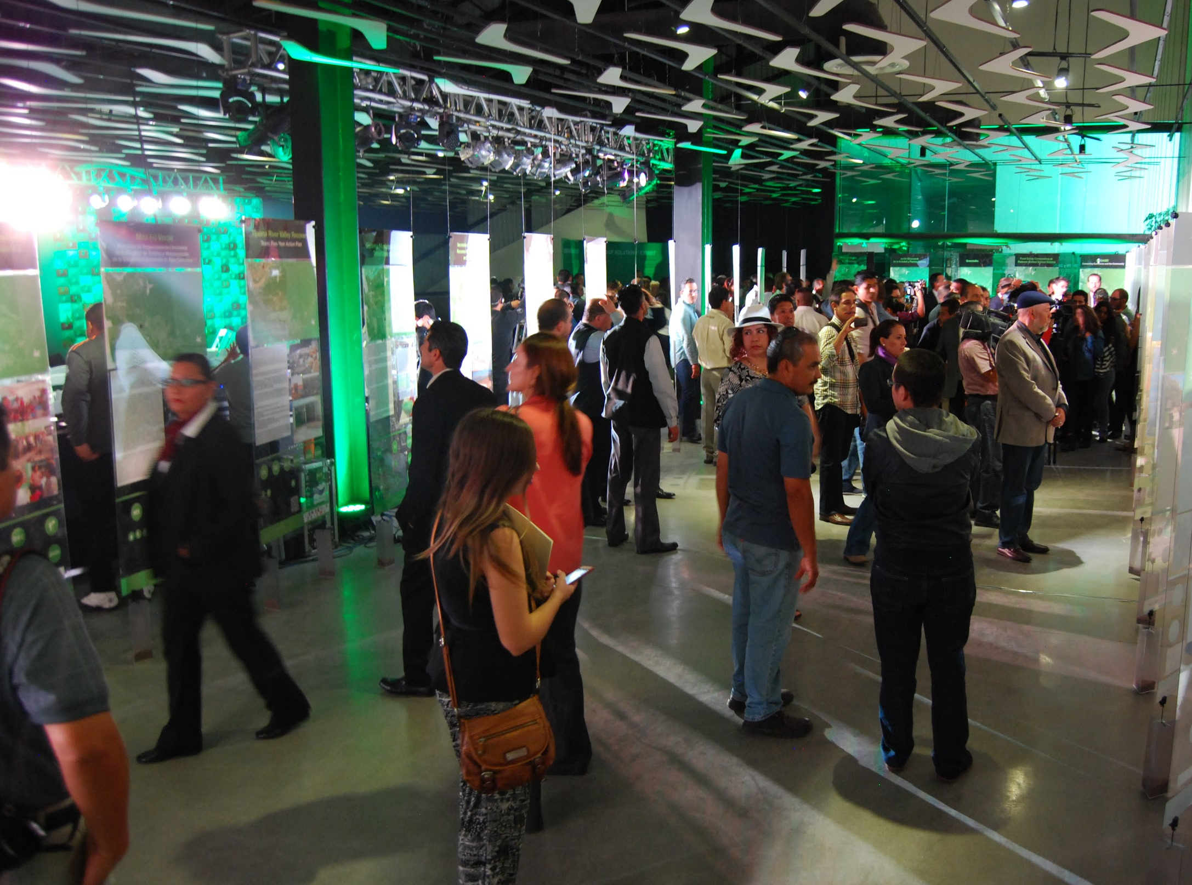
Mapeo Ambiental Binacional
Binational Environmental Project Directory

Slide 13
